Slide 1
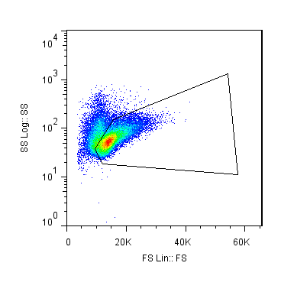
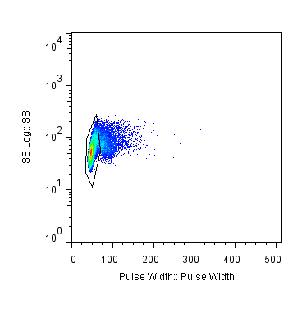
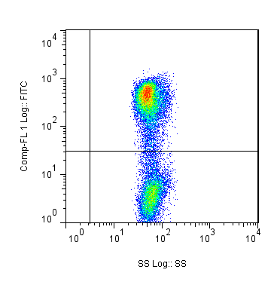
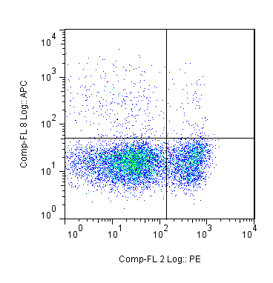
IgM+
TcRβ+
GFP+
Lymphocytes
Single Cells
Side Scatter
Side Scatter
GFP
IgM
Forward Scatter
Pulse Width
Side Scatter
TcRβ

